Slide 1

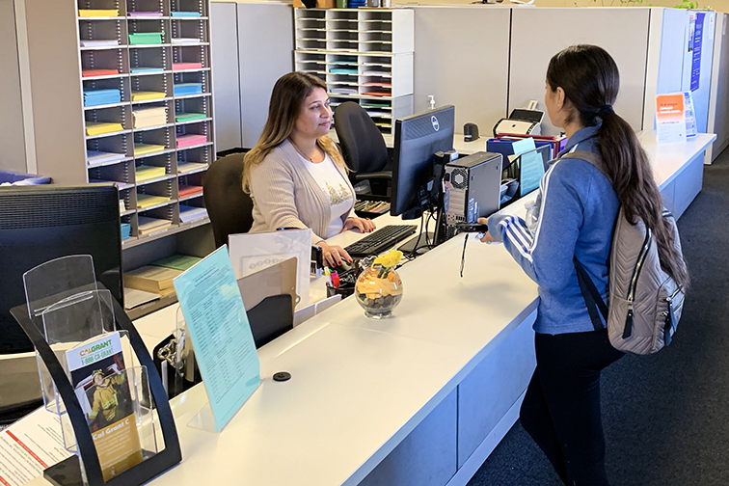
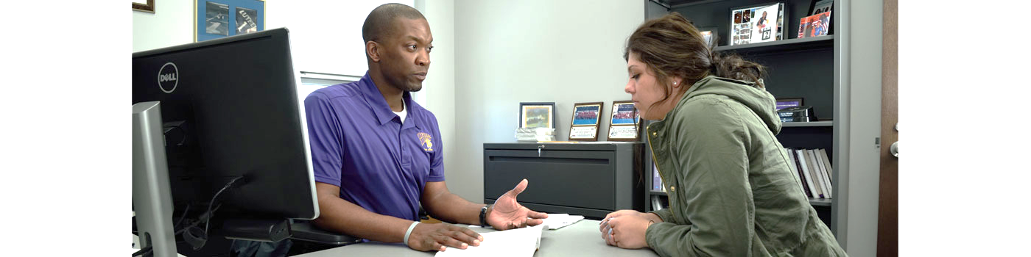
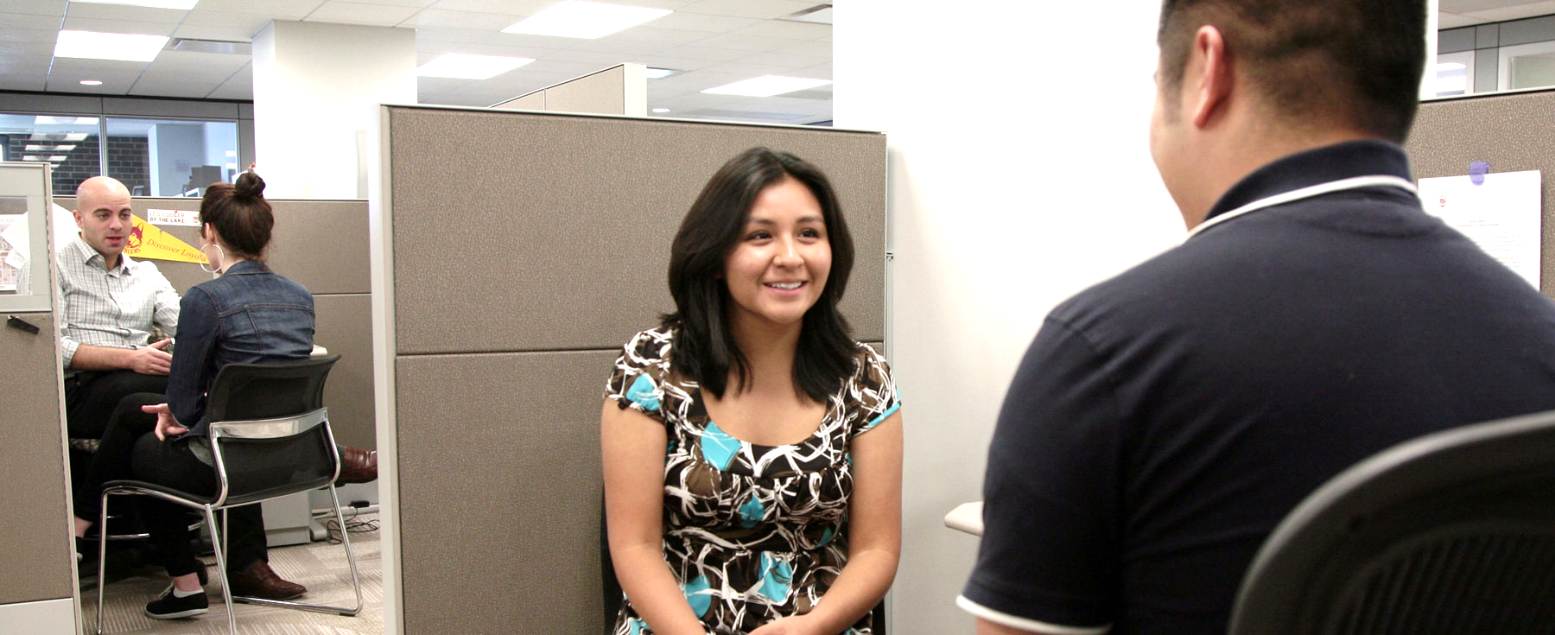
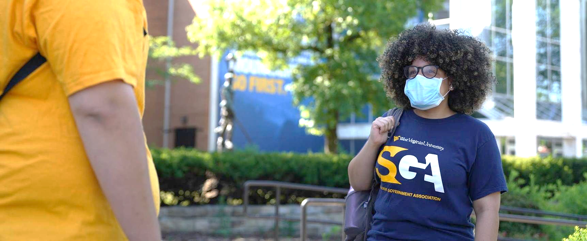



Career & Transfer Services
Kirsten D. Hobbs, M.Ed., CDF
she/her/they/them
Transfer Coordinator
Blue Ridge Community College
Tuesday, November 17, 2020
#N3CSDPA

Slide 2
COVID-19 Trends
What has changed at your institution?
How have you met the career needs in your communities?
What do virtual career & transfer services look like at your institution?
#N3CSDPA

Slide 3
Virtual Fairs
Virtual Career Fairs
Virtual Transfer Fairs
Student and Community Engagement
Videos & Website use
#N3CSDPA

Slide 4
Transfer Trends
Career Trends
Guaranteed Admission Agreements
Guided Pathways AA/AS/AE/AFA
1+1 & 2+2 Partnerships
CAA changes/updates
BDPs & Transfer Equivalencies
RN > BSN & RIBN
Reverse Transfer
Career Changers / Job loss
Remote jobs
Teleworking & Childcare
Business & factory closures
Funding / grants
WIOA & Apprenticeships
#N3CSDPA

Slide 5
Questions and Discussion
Kirsten D. Hobbs, M.Ed., CDF
Transfer Coordinator
Blue Ridge Community College
(828) 694-1801
kd_hobbs@blueridge.edu
N3CSDPA Western / Mountain Region Representative
Thank you for joining us today!
#N3CSDPA

