Slide 1
Self-Service Roundtable
Patrick Holyfield, Dean of Enrollment Management – Stanly CC
Ann Jones, Senior Registrar, CU/CE – Fayetteville Technical CC
Emily Leslie, Business & Cosmetology Success Coach – Stanly CC
Lauren Wilson, Assistant Registrar – Cape Fear CC
Gwendolyn Whitaker, Registrar – Forsyth Technical CC
Monday, November 16, 2020
#N3CSDPA

Slide 2
Today’s Topics
Intro to Self-Service
Self-Service Setup and Support
Empowering Students
Academic Planning, Registration, and Payments Made Easy!
#N3CSDPA

Slide 3
Introduction to Self-Service
#N3CSDPA

Slide 4
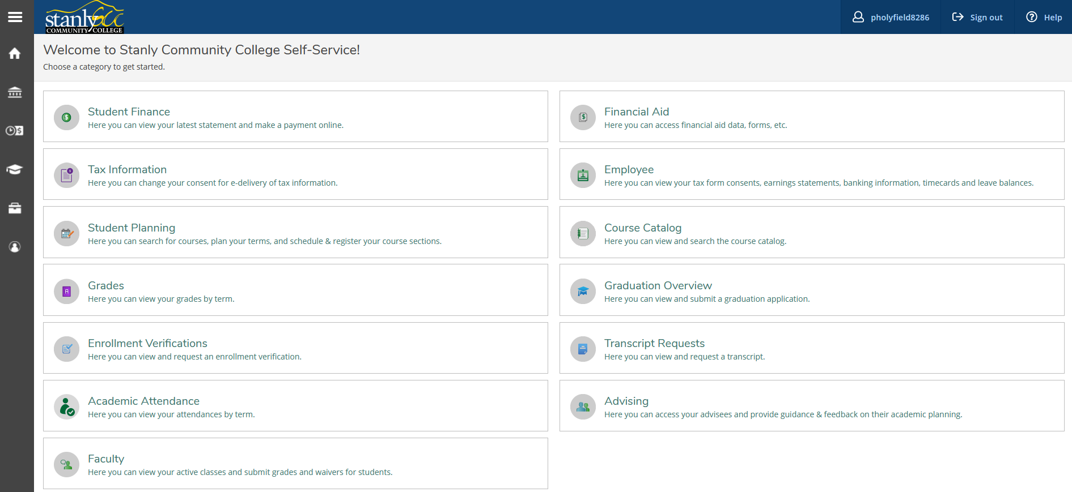
Introduction to Self-Service
#N3CSDPA

Slide 5
Introduction to Self-Service
Student View
Student Finance
Financial Aid
Tax Information
Student Planning
Grades
Enrollment Verifications
Academic Attendance
Transcript Requests
Graduation Overview
Course Catalog
Advisor View – Advising
Course Plan
Timeline
Progress
Course Catalog
Notes
Plan Archive
Test Scores
Unofficial Transcript
Grades
Petitions & Waivers
Graduation Application
#N3CSDPA

Slide 6
Self-Service Setup & Support Lauren Wilson, Assistant Registrar – Cape Fear Community College
#N3CSDPA

Slide 7
Self-Service Setup & Support
It takes a village!
Key discussions with various departments & IT Services before setup of Self-Service can occur.
Use the current catalog to base how Self-Service is set up at the institution.
Most current version of the SetUp guide that was used by my institution was Sept 29 2015. It can be found on the Ellucian HUB.
#N3CSDPA

Slide 8
Self-Service Setup & Support
Ask Hard Questions!
Does your institution want to use Sample Course Plans for students as “What If” scenarios?
If so, does your institution have enough staffing to maintain the setup of course blocks and curriculum tracks each catalog year?
What roles have been decided for faculty/staff at your school?
Does your institution have an Advising Center or does the Faculty carry the advising load?
Does your institution want to require Advisor Approved registration or allow students to register on their own?
How does your institution want it to appear aesthetically?
#N3CSDPA

Slide 9
Appearance Settings
Some Setup is Time Consuming!
•Allow for ample time for folks to edit screens to the desired settings.
Subject Removal (SUBJ)
•Shows within the Self-Service Course Catalog which subjects are pertinent to your institution
Curriculum Tracks with Course Blocks (CUTK/CSBL)
•Required set up if using Course Plans and/or View a Sample Program
Pseudo Courses Creation (XUIC/XUSU/CRSE)
•Required set up if program of study has “pick list or free electives”
#N3CSDPA

Slide 10
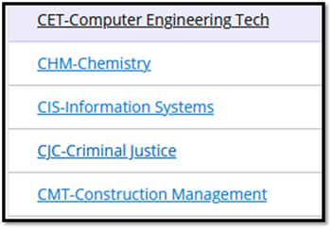
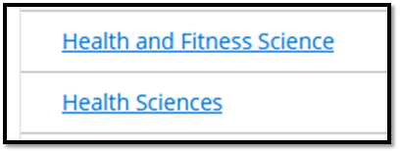
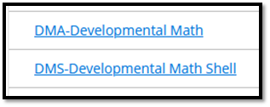
SUBJ and Set Up Appearance
SUBJ dictates what is seen by the user in the Self-Service Course Catalog. Decide aesthetically as an institution how SUBJ is labeled.
Are the subject areas removed that are not applicable to your institution?
#N3CSDPA

Slide 11
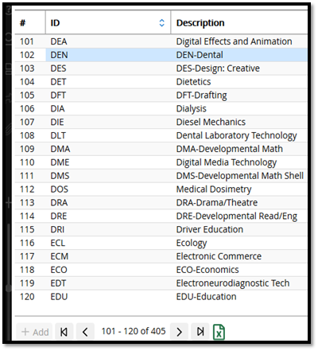
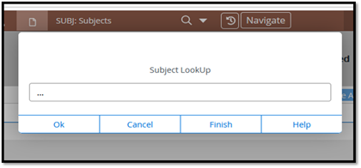
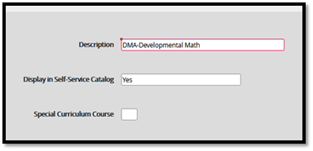
Appearance Settings - SUBJ
SUBJ houses all subjects within the system. Some are not taught at all institutions and they must be “removed” from the SUBJ screen so they do not appear in your Course Catalog within Self-Service.
#N3CSDPA

Slide 12
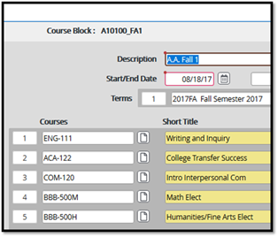
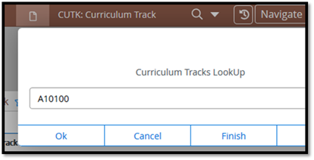
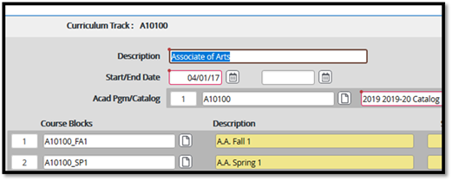
CUTK/CSBL
Curriculum Tracks and Course Blocks need built based on each program of study offered in the catalog and each semester of the block schedule.
If the student’s program of study has “free electives/pick list” classes, pseudo courses need built also.
#N3CSDPA

Slide 13
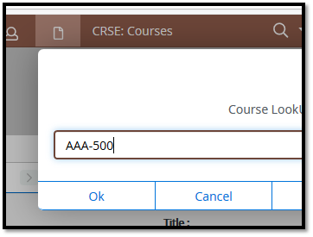
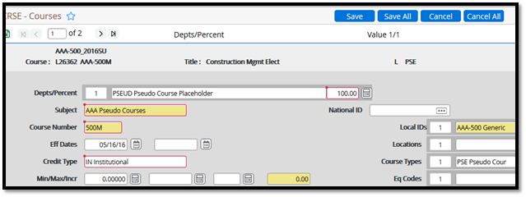
Pseudo Courses
Use XUIC to download the courses into Colleague.
Courses are “AAA-500” and “BBB-500”.
Use XUIC/XUSU/CRSE to create the placeholder courses for Course Plans.
#N3CSDPA

Slide 14
Set Up Maintenance
Routine maintenance is required when using Curriculum Tracks and Pseudo Courses, and SUBJ when new programs come online and new class subjects are adopted.
Each change that occurs within the Catalog and Programs of Study need to be edited within Colleague so Self-Service reflects the correct information.
It is a student-friendly system once setup is complete and routine maintenance occurs.
#N3CSDPA

Slide 15
Empowering Students Emily Leslie, Business & Cosmetology Success Coach – Stanly Community College
#N3CSDPA

Slide 16
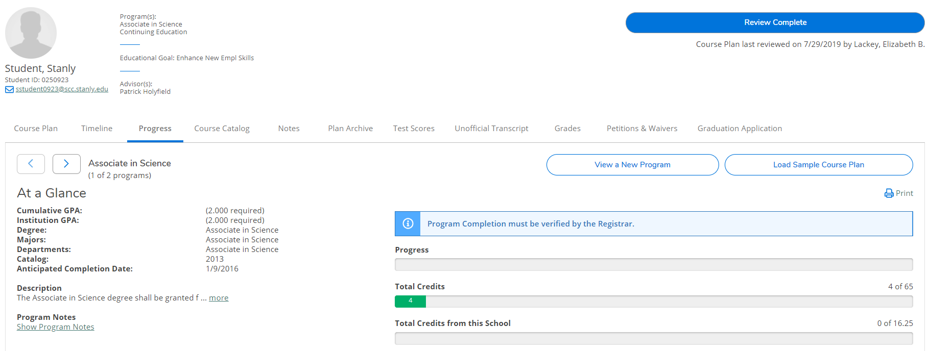
Empowering Students
#N3CSDPA

Slide 17
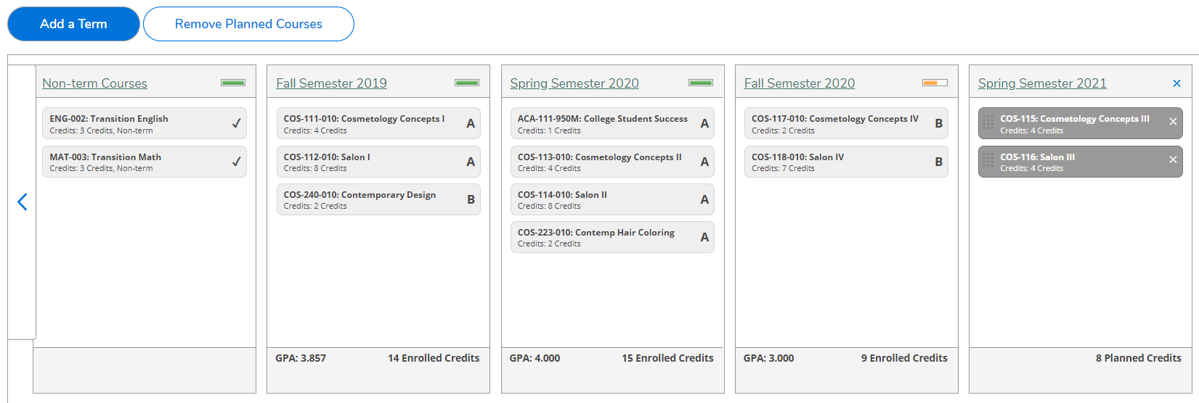
Empowering Students
#N3CSDPA

Slide 18
Academic Planning & Registering Ann Jones, Senior Registrar – Fayetteville Technical Community College Gwendolyn Whitaker, Registrar – Forsyth Technical Community College
#N3CSDPA

Slide 19
Academic Planning & Registration
Registration as a student is a simple process in which once there, they can do everything they need to do to plan and register for classes
Once they are logged into their institution’s Self-Service portal, select Student Planning
#N3CSDPA

Slide 20
Academic Planning & Registration
From there, students can then check their progress, by viewing “My Progress”
This allows them to see the classes they have completed, plus those that are remaining in their program of study
#N3CSDPA

Slide 21
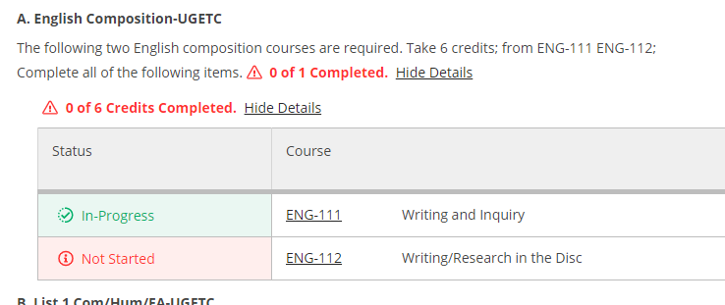
Academic Planning & Registration
#N3CSDPA

Slide 22
Academic Planning & Registration
#N3CSDPA

Slide 23
Academic Planning & Registration
To view your schedule, you will then select “Plan & Schedule”
#N3CSDPA

Slide 24
Academic Planning & Registration
And finally….
#N3CSDPA

Slide 25
Payments Made Easy! Emily Leslie, Business & Cosmetology Success Coach – Stanly Community College
#N3CSDPA

Slide 26
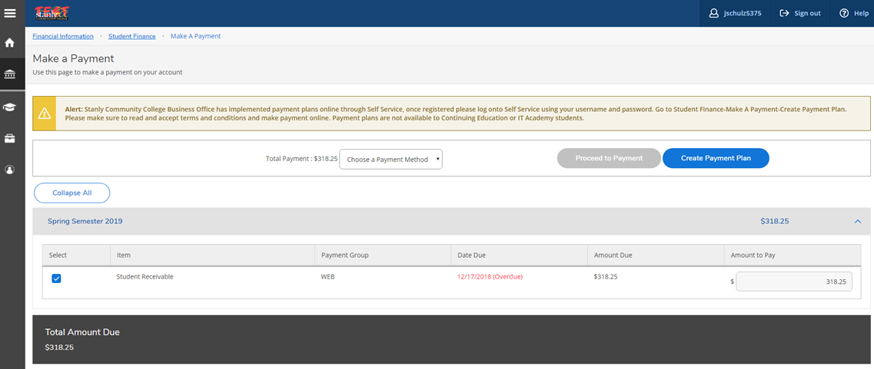
Payments Made Easy! What a student sees on Self-Service
#N3CSDPA

Slide 27
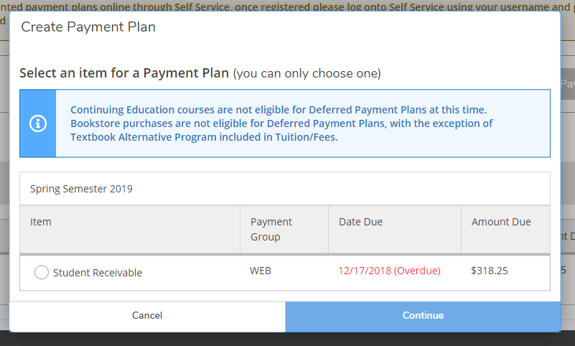
Payments Made Easy!
#N3CSDPA

Slide 28
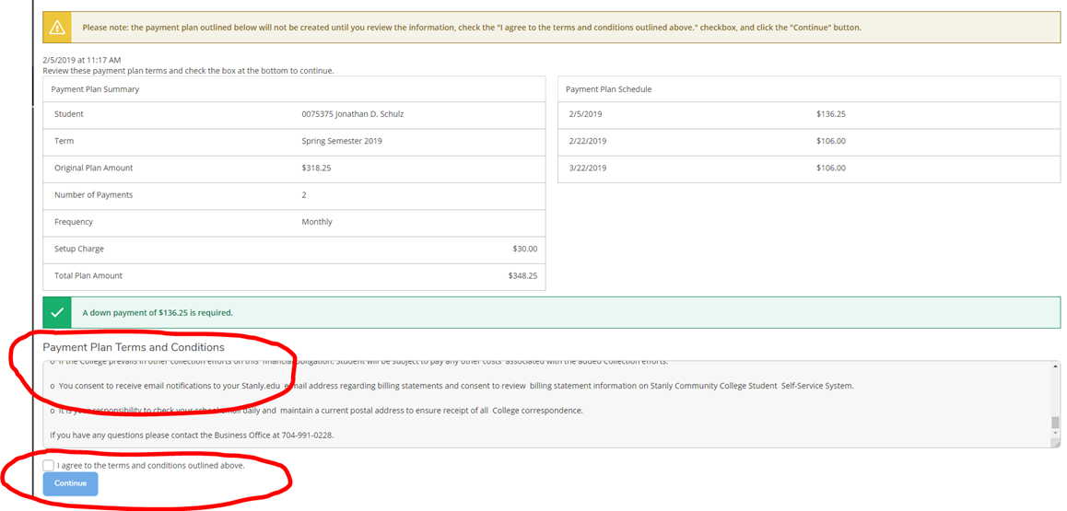
Payments Made Easy!
#N3CSDPA

Slide 29
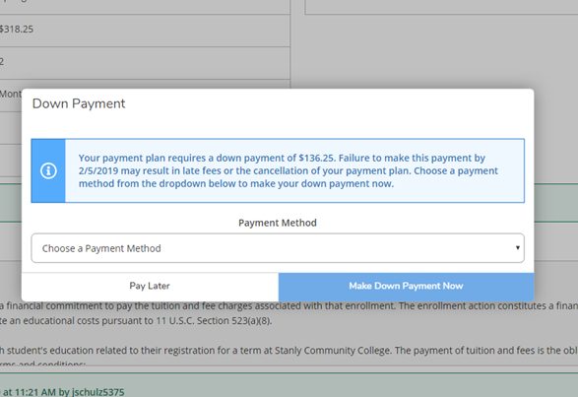
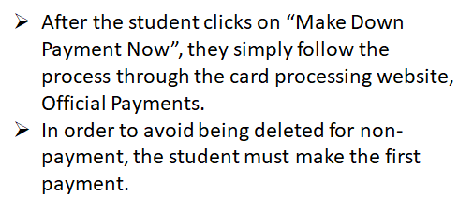
Payments Made Easy!
#N3CSDPA

Slide 30
Questions and Discussion
Thank you for joining us today!
Patrick Holyfield / pholyfield8286@stanly.edu
Ann Jones / jonesma@faytechcc.edu
Emily Leslie / eleslie8929@stanly.edu
Lauren Wilson / lwilson@cfcc.edu
Gwendolyn Whitaker / gwhitaker@forsythtech.edu
#N3CSDPA

